Slide 1
SURGE Design Presentation:
Activist Archetype

Slide 2
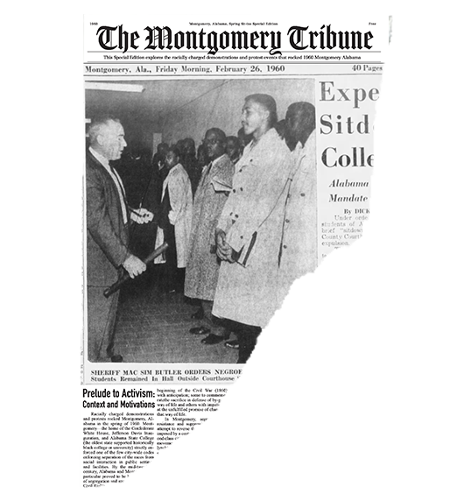
Game Design
The Research
The context and culture of the Civil Rights Movement and Alabama during that time
The events that took place on the ASC campus in 1960
Project goals:
Teach students empathy and perspective taking through the experiences of the student activists
Notes:
The team has done extensive research into the Civil Rights Movement and the culture surrounding the 1960s. We did this in order to tell a comprehensive story of the students who took their own place in activism by sitting in at the Courthouse Grille. The goal of this project is to create an experiential-learning tool that will help teach students empathy and perspective taking. Why a game? This gives players an opportunity to engage in an immersive retelling of events that took place on ASC’s campus in 1960 Montgomery. By interacting and channeling the lived experiences of the student activists, we hope that the player’s choices throughout the game will inspire change and the attitude to do what’s right.

Slide 3
Why a game?
Notes:
Why a game? This gives players an opportunity to engage in an immersive retelling of events that took place on ASC’s campus in 1960 Montgomery. By interacting and channeling the lived experiences of the student activists, we hope that the player’s choices throughout the game will inspire change and the attitude to do what’s right.

Slide 4
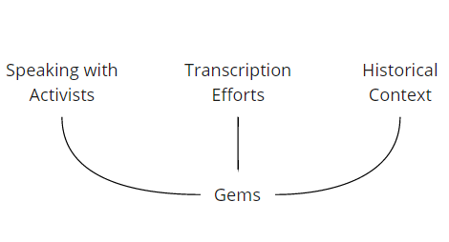
Game Design: CONTENT
What are the gems?
Gem Development
Assigning the relevance and importance of the historical data to decide what to implement into the game
Notes:
We are leveraging our research based on what we call the “Gems”, The gems are events, reactions, and litigation that provide the context for the player and were gathered through interviews with the activists that were present, reviewing transcripts, and of course the history surrounding sit in in 1960.
The development of the gems and the discussion about which would be included was based on their relevance and importance to the game. We had to decide which gems were important in telling the story of the student sit-ins at the Courthouse Grille. Our biggest questions were: How much of the background of what was happening in Montgomery is important to understand the student’s motivations, Which are the gems that help you understand the culture of Montgomery and Alabama at the time, and

Slide 5
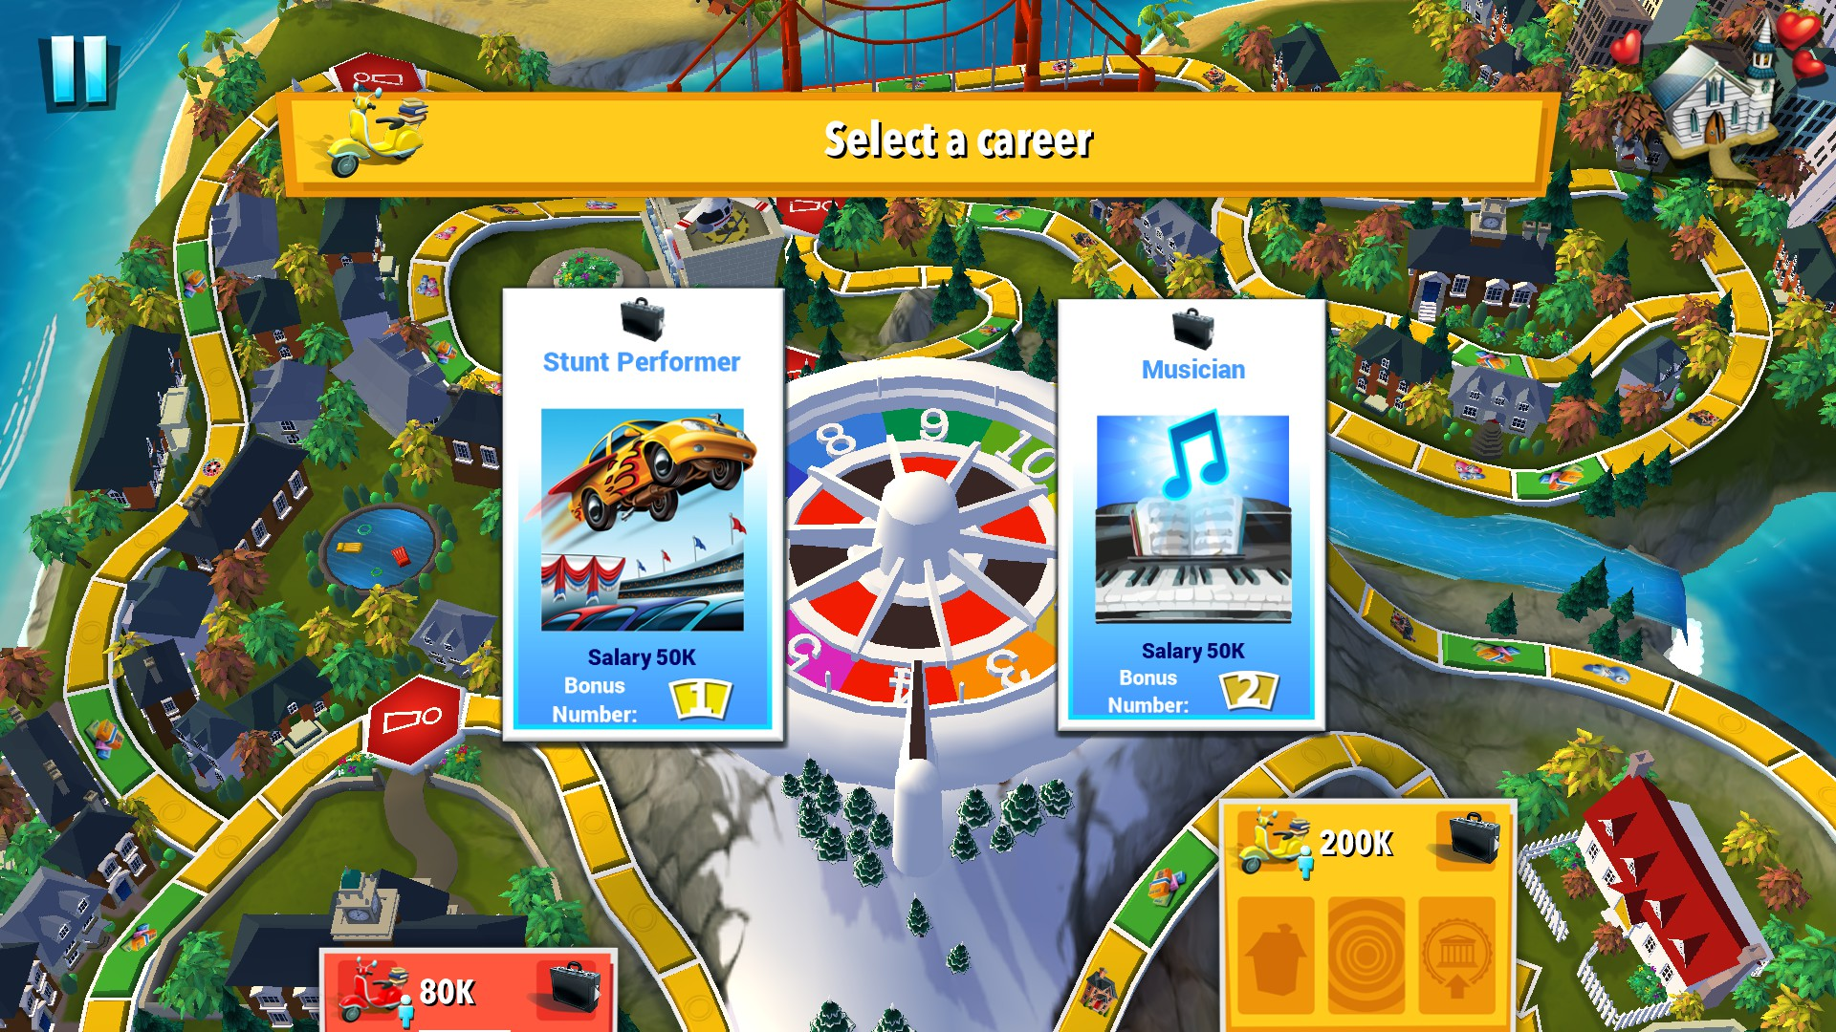
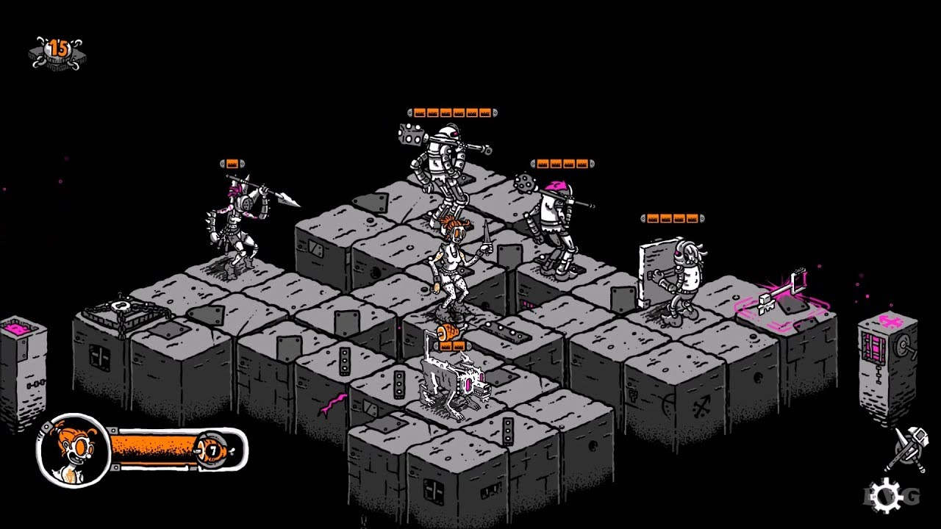
Game Design: Research
Game and Mechanic Research
Learning through playing
Compiling and collecting an archive of mechanics used in various games
Recontextualizing existing mechanics to fit our game
The Game of Life (2015)
Plunge (2015)
Notes:
We did a lot of preliminary research by delving into different games and analyzing mechanics that we could leverage for the experience we were trying to create.
Game of Life: A familiar games that takes you through the choices of growing up (Should you go to college, careers, having kids, buying a house). There was something about the game board aesthetic and spinning the wheel that made it a lot of fun. It also allowed us to think about the possibility of integrated minigames to make gameplay engaging

Slide 6
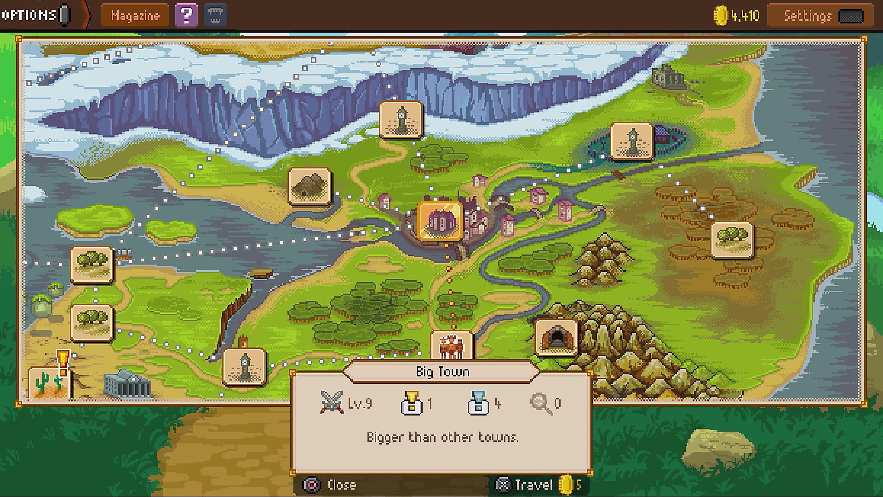
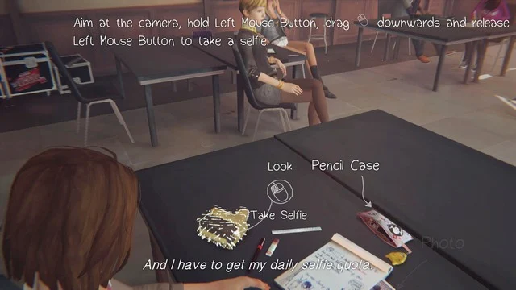
Game Design: Research
The Knights of Pen & Paper II (2015)
Ability to assemble a team with different classes or character types
Travelling: Unlock areas by completing special tasks, learning info, or following the story
Limited to no dialouge
Life is Strange (2015)
First person perspective
Every interaction and action has consequences
Alternate ending: Allows for a difference in perspective, depending on path chosen.
Notes:
We did a lot of preliminary research by delving into different games and analyzing mechanics that we could leverage for the experience we were trying to create.
Game of Life: A familiar games that takes you through the choices of growing up (Should you go to college, careers, having kids, buying a house). There was something about the game board aesthetic and spinning the wheel that made it a lot of fun. It also allowed us to think about the possibility of integrated minigames to make gameplay engaging

Slide 7
Game Design: Archetype
Activist Archetype
The Activist player is passionate about fighting against injustice.
Character goals:
Align themselves with the students who are getting involved and make a difference
Protesting
Attending meetings and rallies
Sitting in
Notes:
I worked on the Activist archetype. The Activist player is passionate about fighting against injustice. Their goal on campus is to align themselves with the students who are getting involved and make a difference through protesting, attending meetings and rallies, and ultimately sitting in.

Slide 8
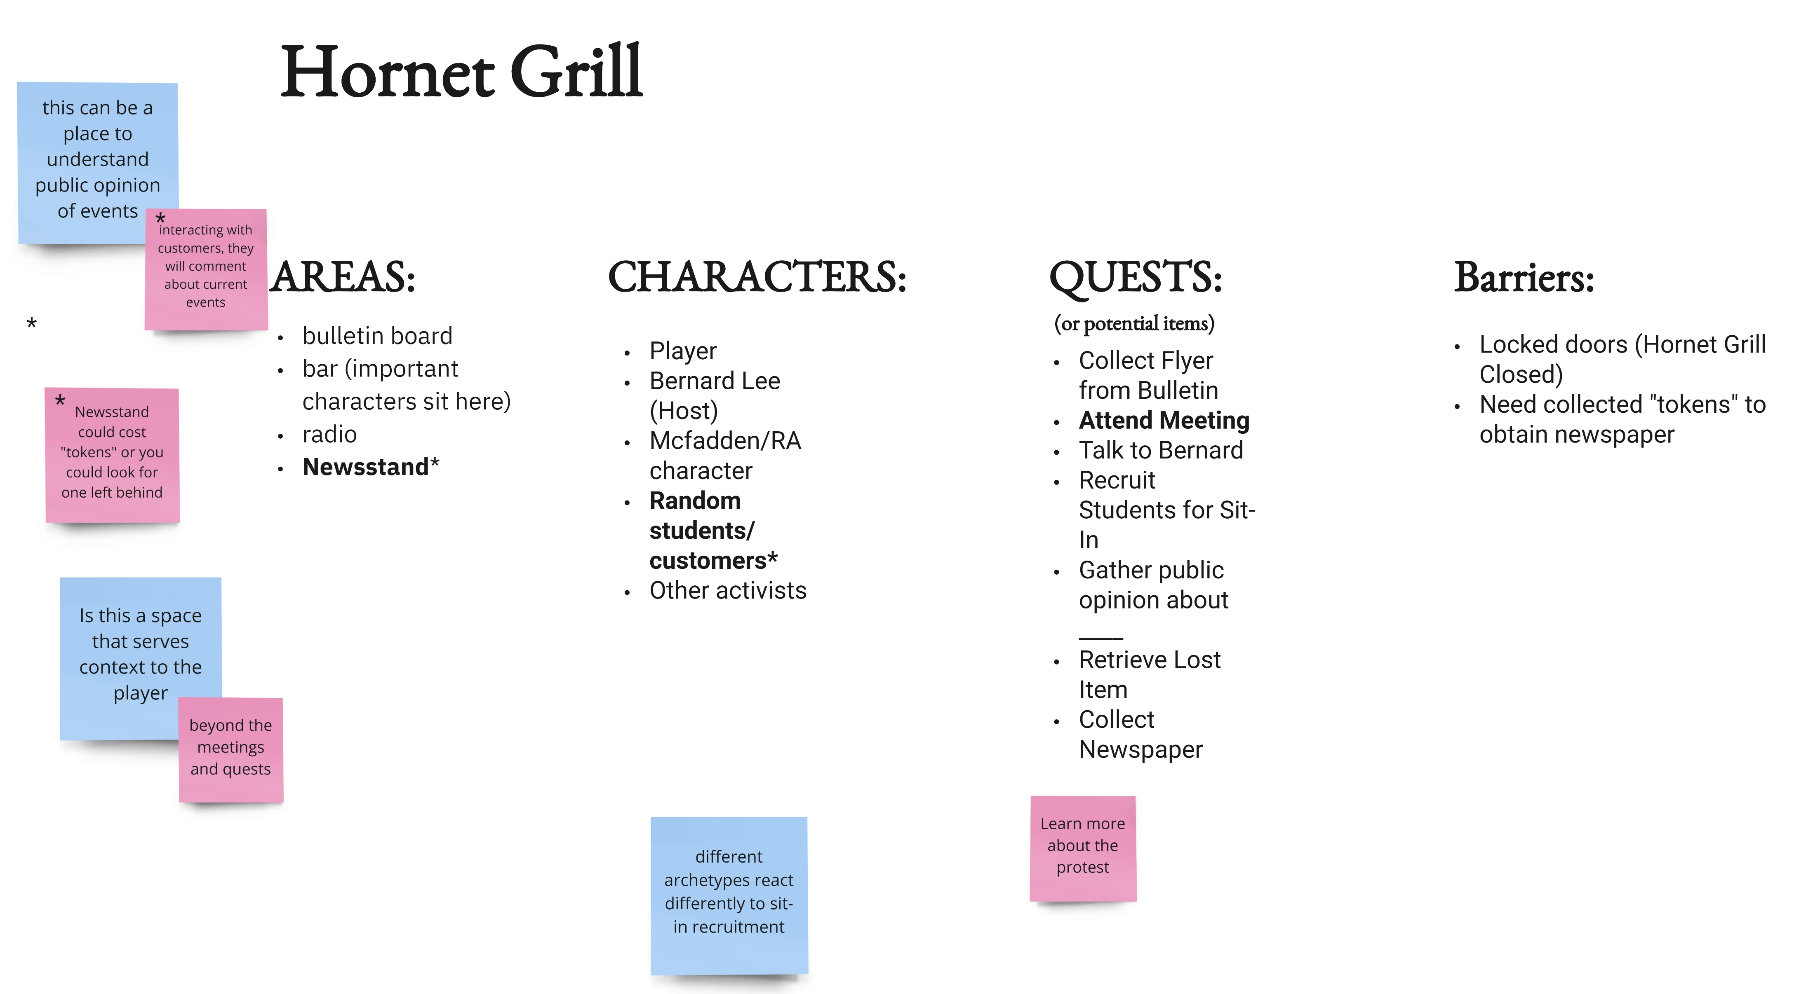
Game Design: Archetype
Point A

Slide 9
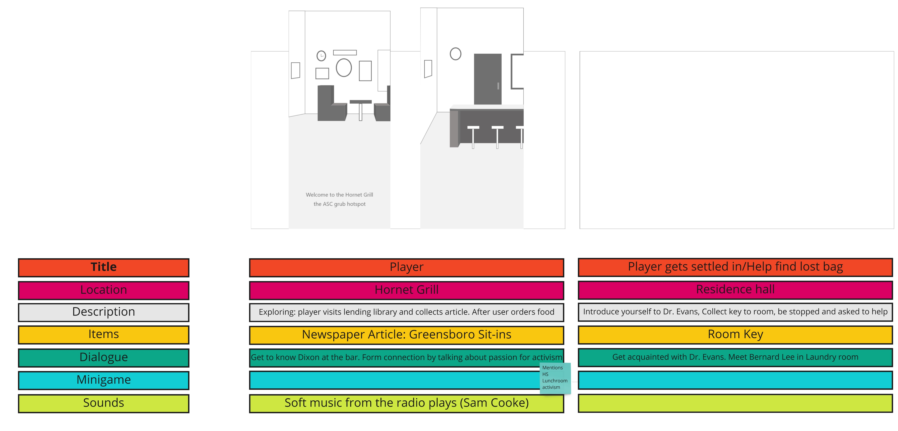

Slide 10
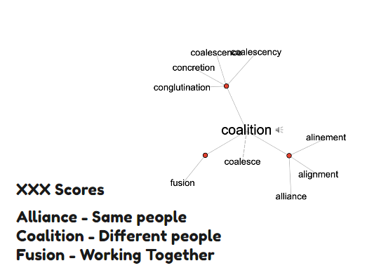
Alignment scores
Notes:
Why point system was necessary? Other iterations? How to make content drive how you move through the world

Slide 11
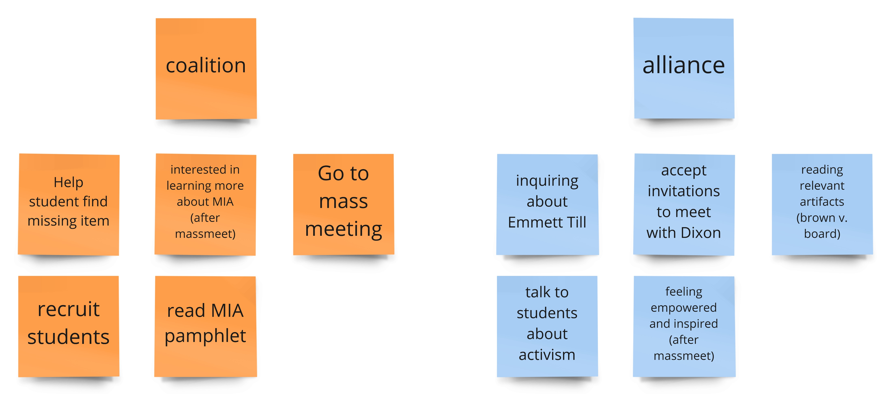

Slide 12
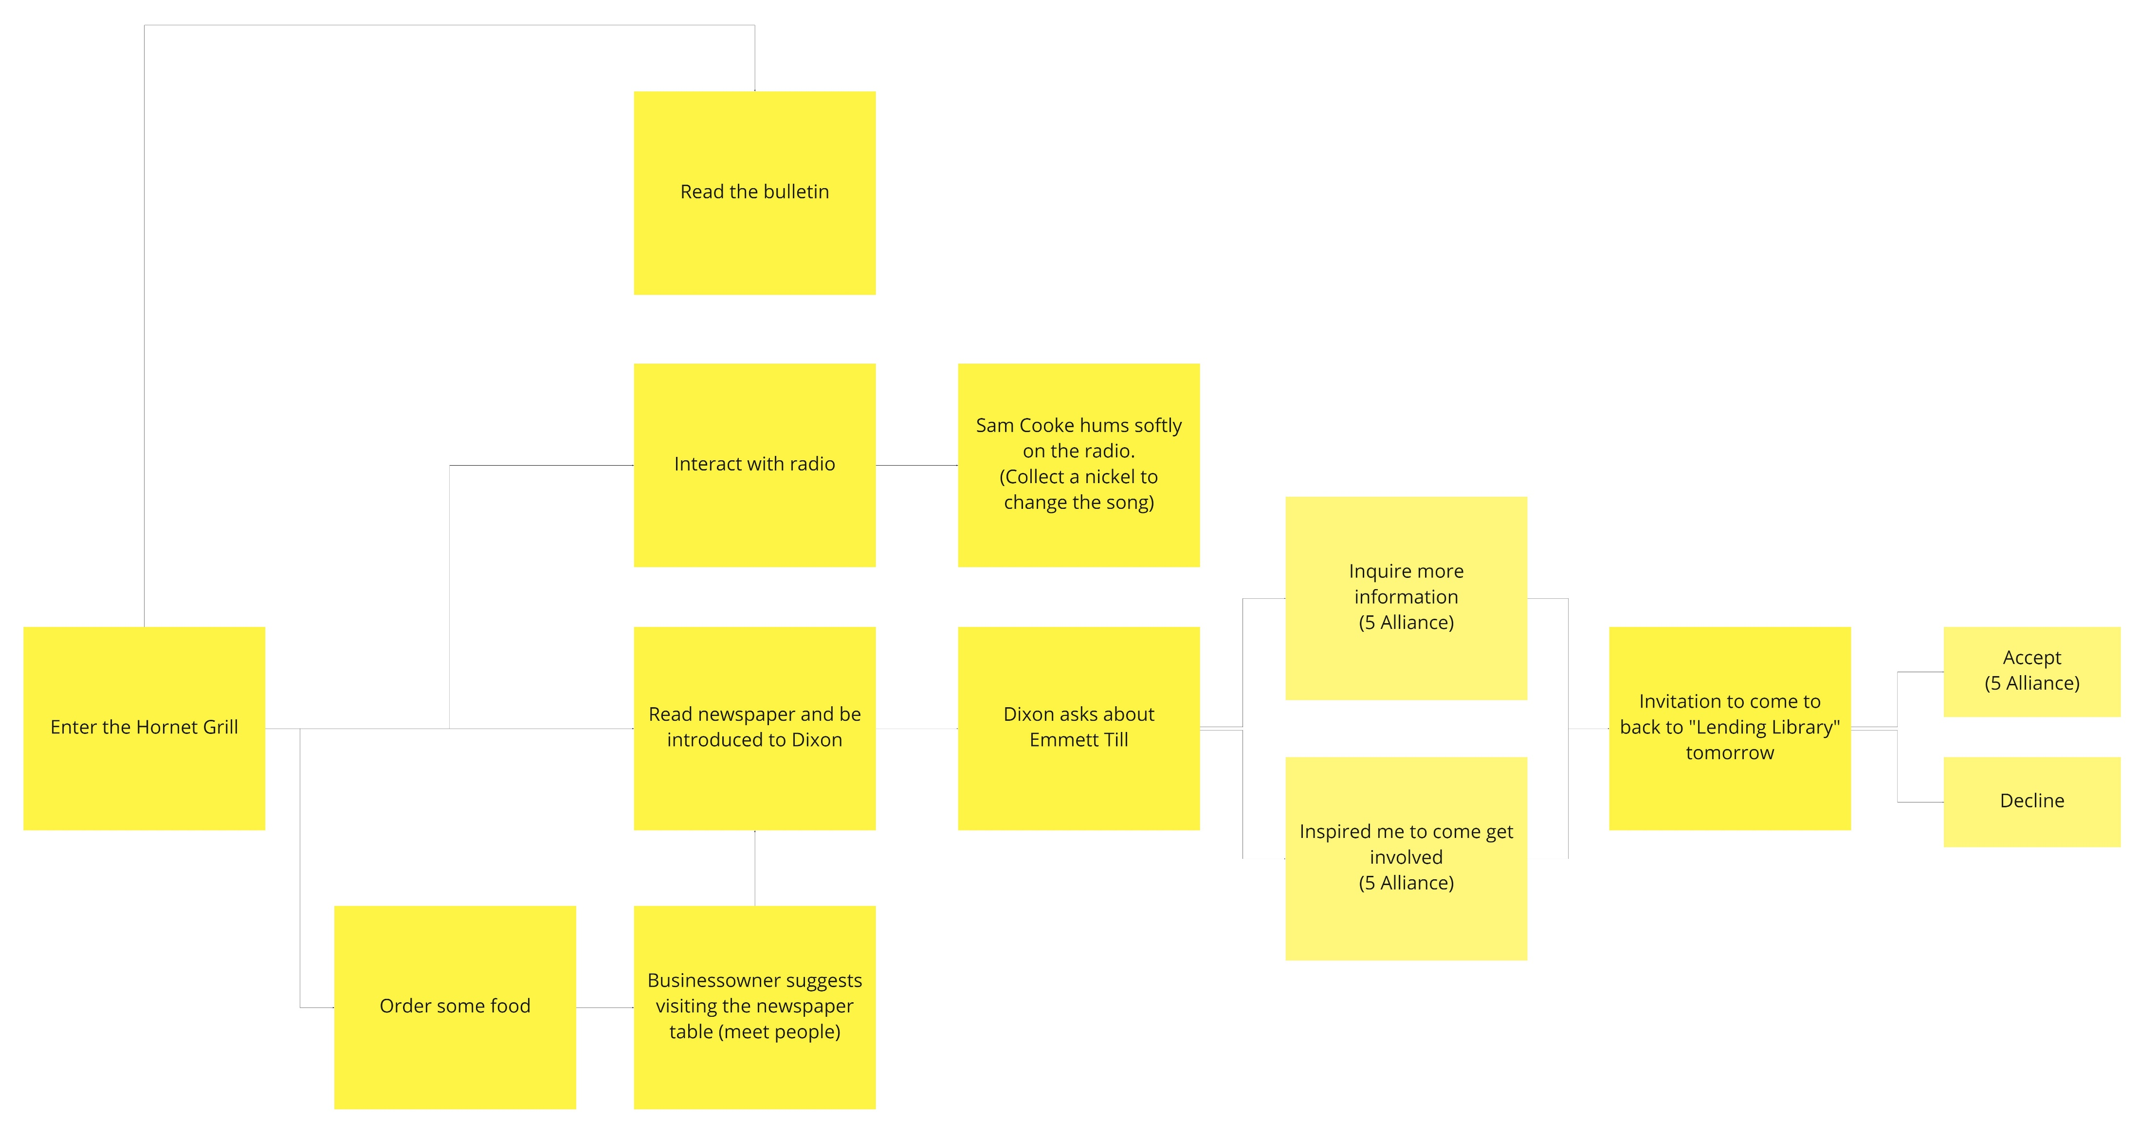
Point Tree

Slide 13
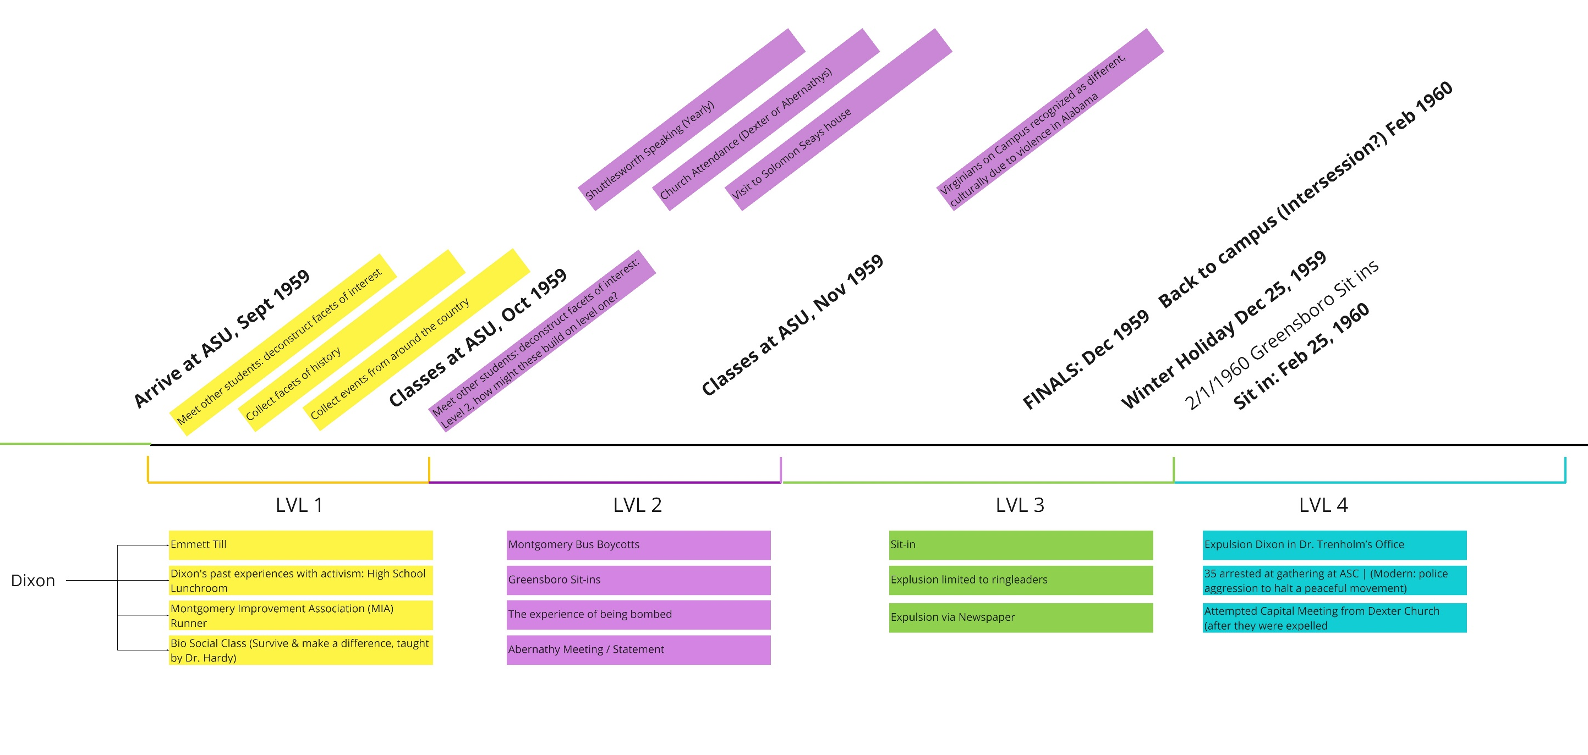
Game Design: Research

Slide 14
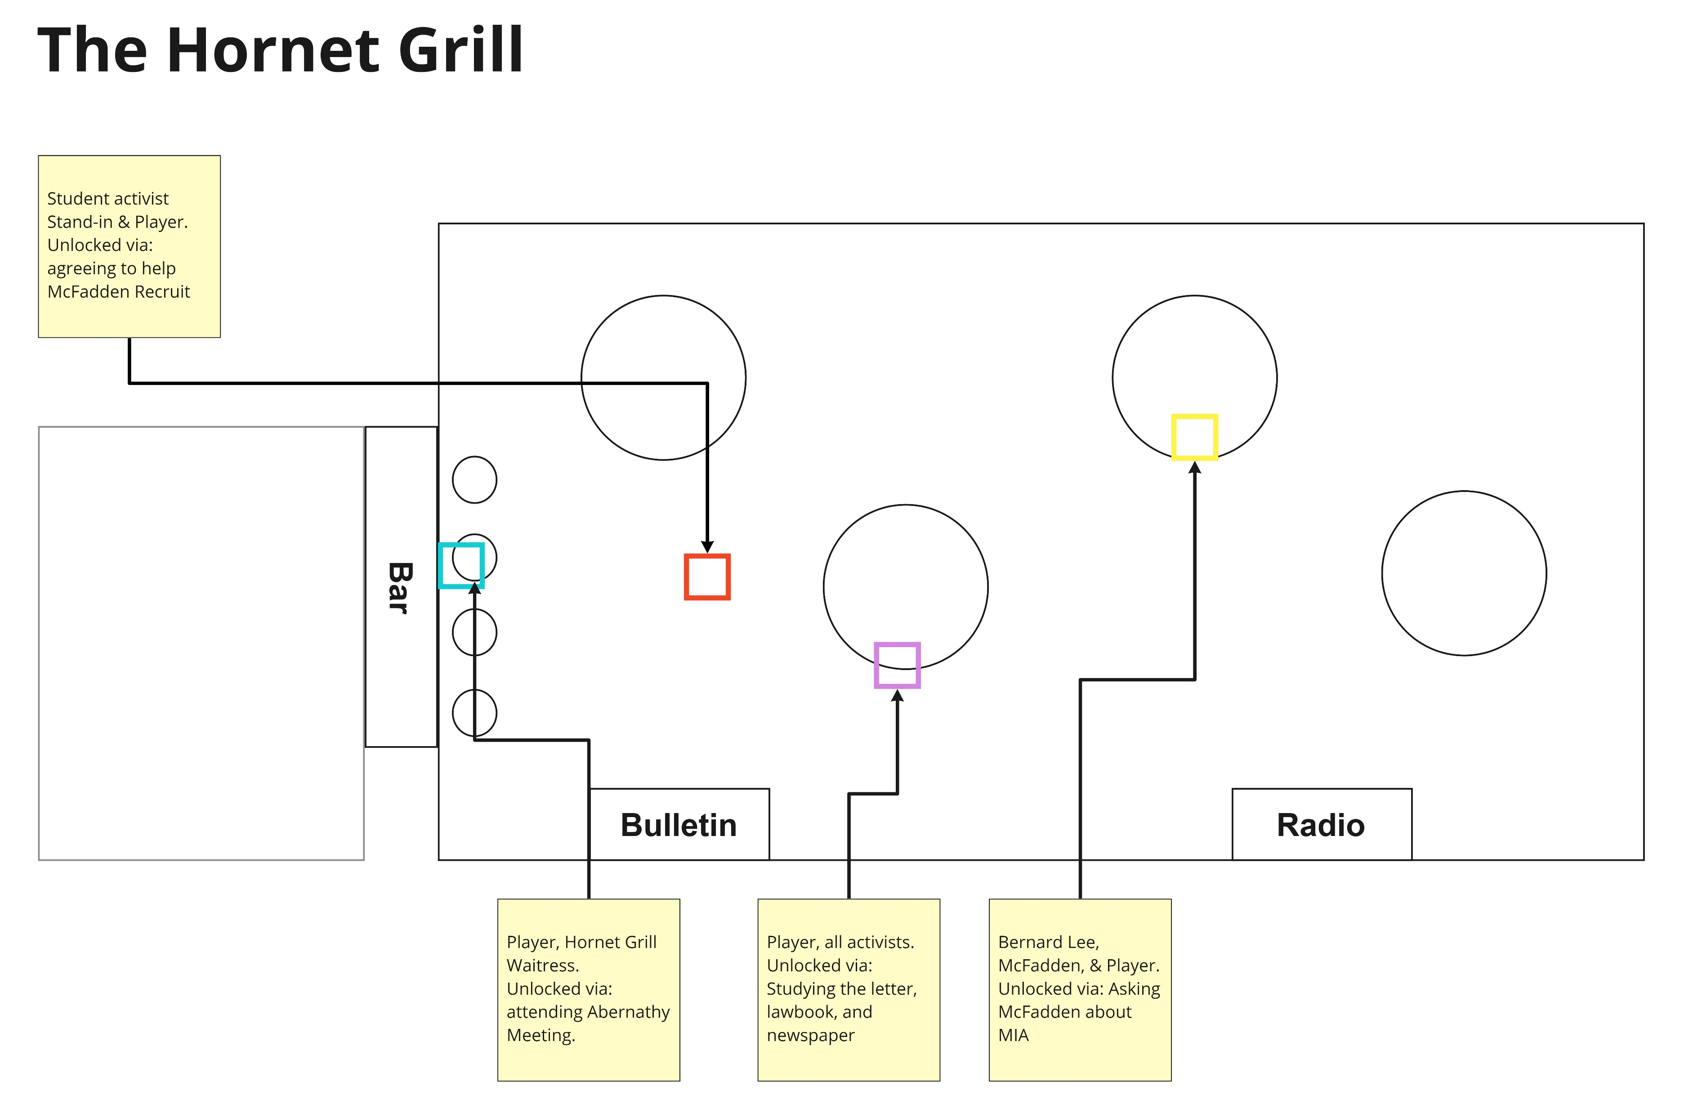
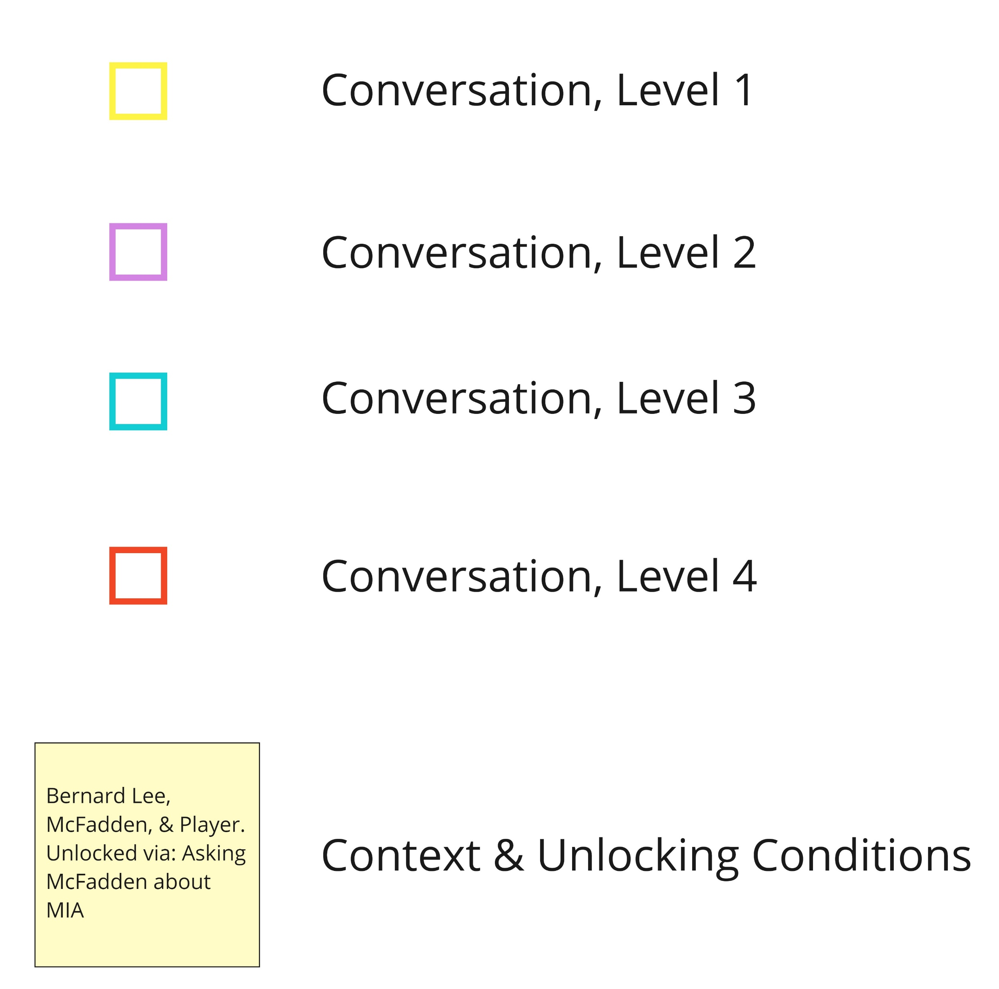
Game Design: Research

Slide 15
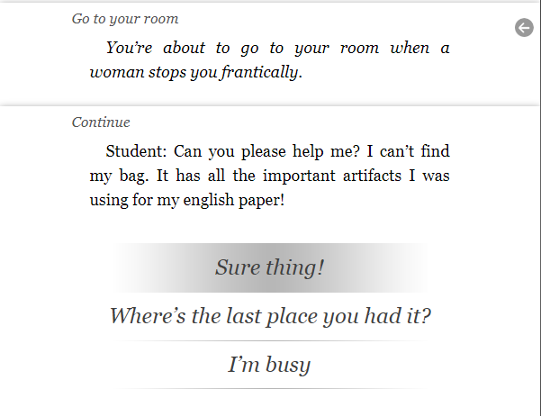
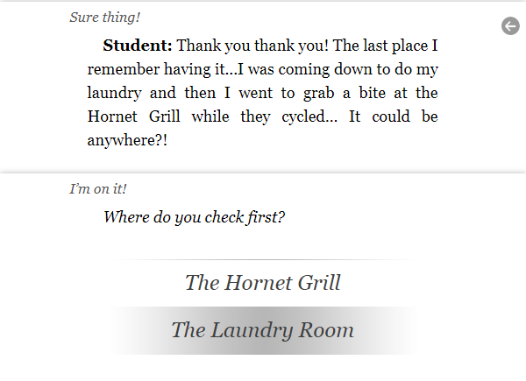
Game Design: Research
Inklewriter examples

Slide 16



Game Design: Research + Next Steps
Next Steps:
Dialogue development
Further ideation and assemblage of concept art
Build from foundations of sound development
Sam Cooke
Johnny Ace
“Pledging My Love To You”
Concept Art

Slide 17
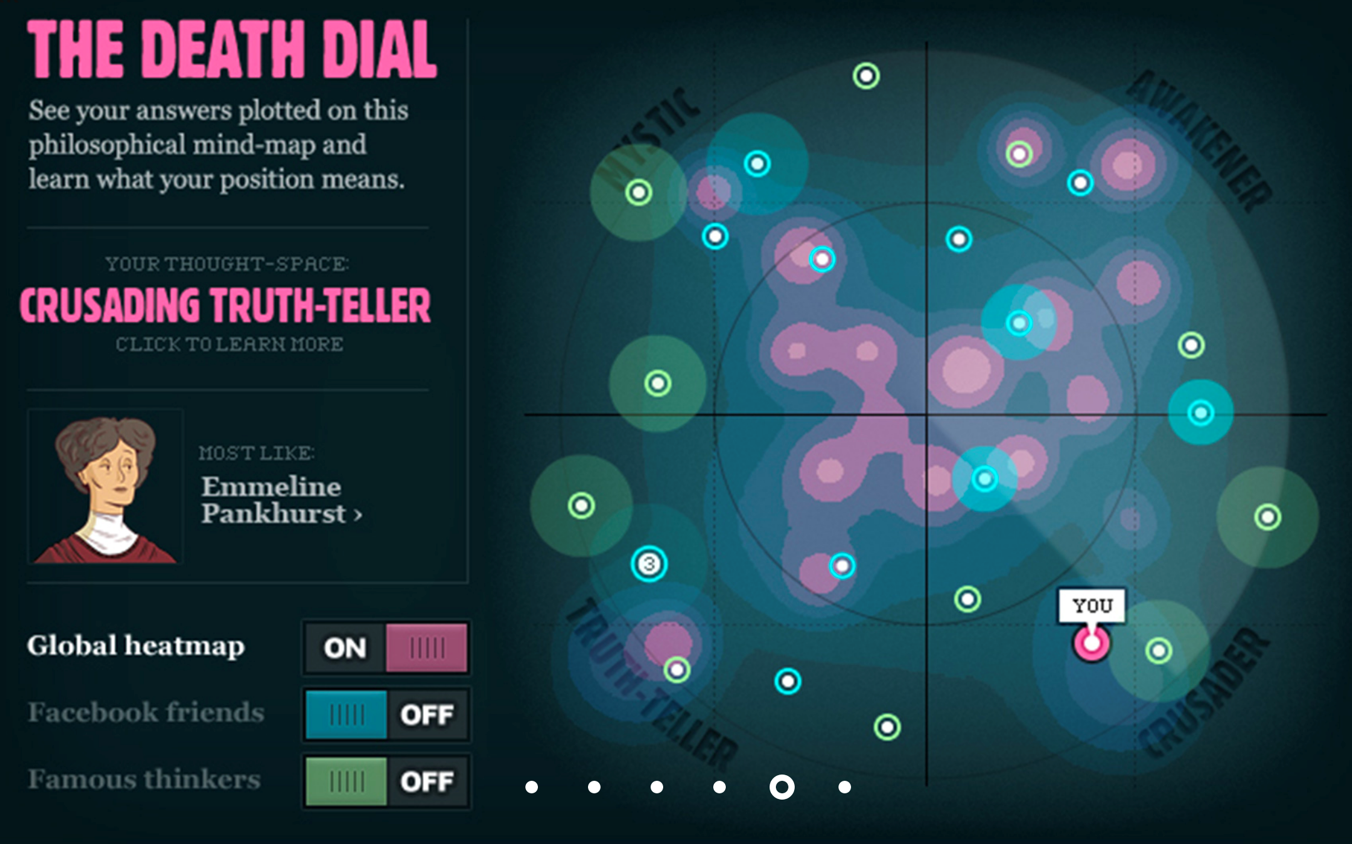
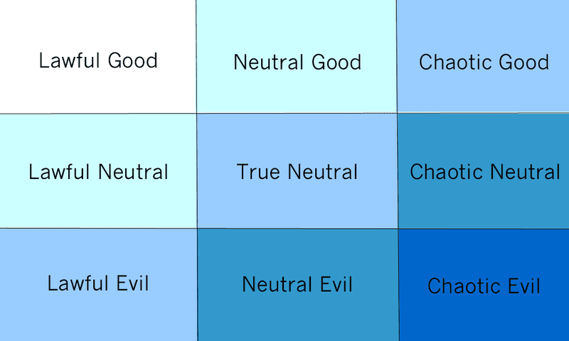
Game Design: Research + Next Steps
Next Steps:
Possible paths for alignment scores and development of their function
Recontextualize quiz mechanic
The Death Dial
The End (2011)
Dungeons and Dragons Alignment

